Slide 1


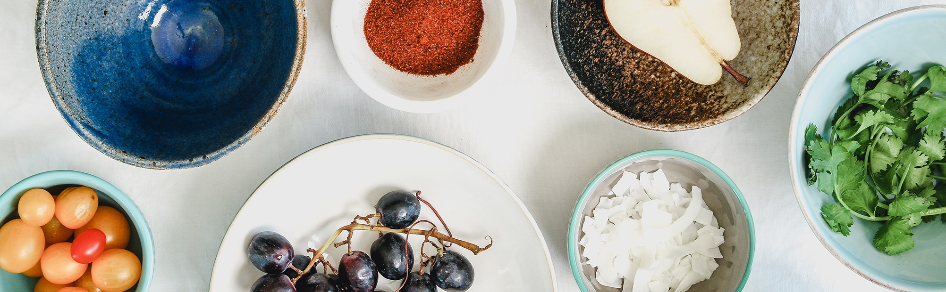
CIS 591 – Team D2
Simran Mansharamani (smansha1@asu.edu)
Ikya Nallapuneni (inallapu@asu.edu)
Rohit Kadhane (rkadhane@asu.edu)
Shubham Barbhai (sbarbhai@asu.edu)
Mitsu Kansagara (mkansaga@asu.edu)

Slide 2
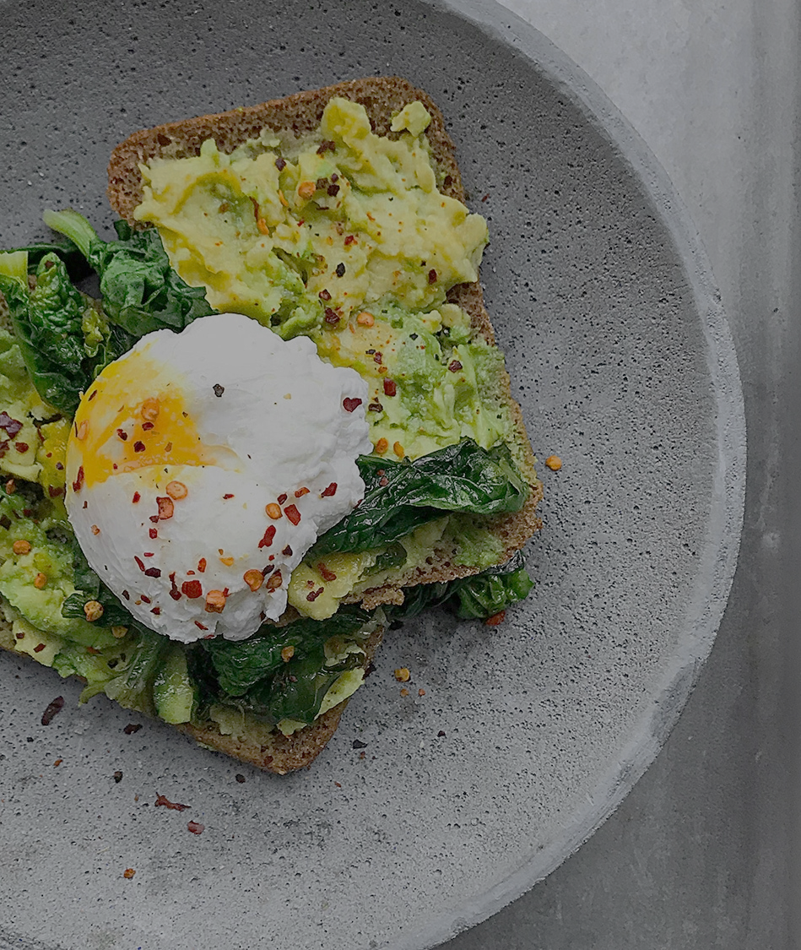
Instacart
Company Background:
Instacart is an American delivery company that allows customers to order groceries from multiple retailers with shopping being done by a personal shopper.
Our interest:
Our interest lies in enhancing the customer experience by making the application more engaging and personalized.

Slide 3
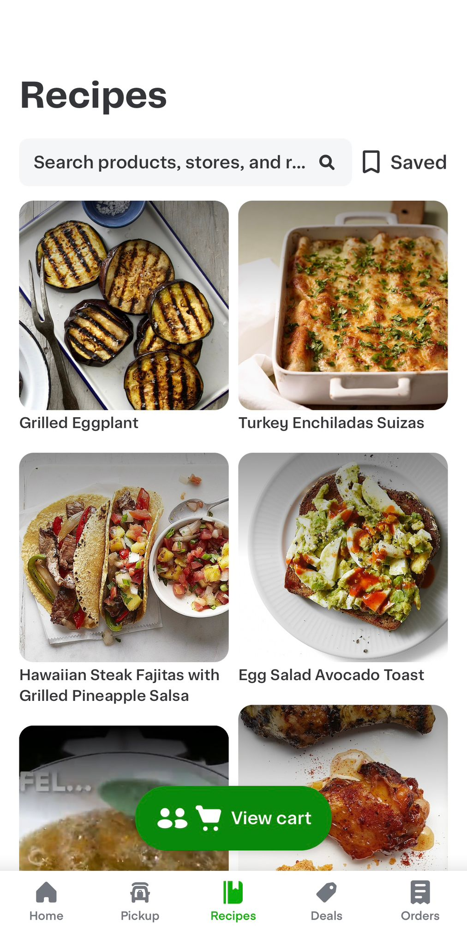
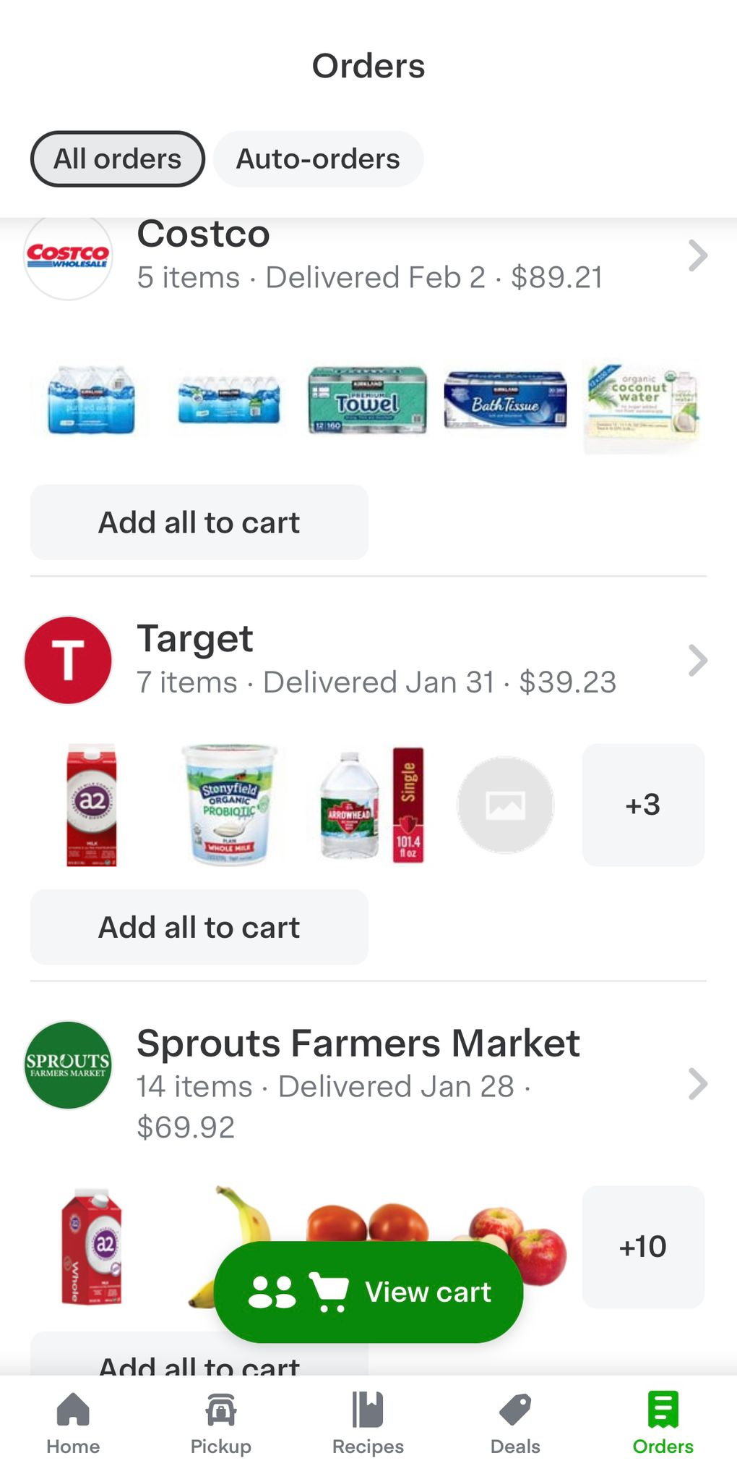

Business Process
Business Process
Proposed Changes
Offering a list of recipes to increase order value and increase customer engagement.
Recommending recipes based on customer purchase patterns and preferences to personalize the shopping experience.
Collaborative + Content-based Recommendations

Slide 4
Business Question
Question 1: What food recipes can we incorporate into our system that are currently trending and highly recommended on social media?
Question 2: Can we utilize this data to build a content + collaborative recommendation system as a long-term project?

Slide 5
Workflow
Subreddits
r/recipes
r/Healthy_Recipes
r/veganrecipes
PRAW Code
Pre-processing
Recipe Recommendation
Sentiment Analysis
LDA

Slide 6
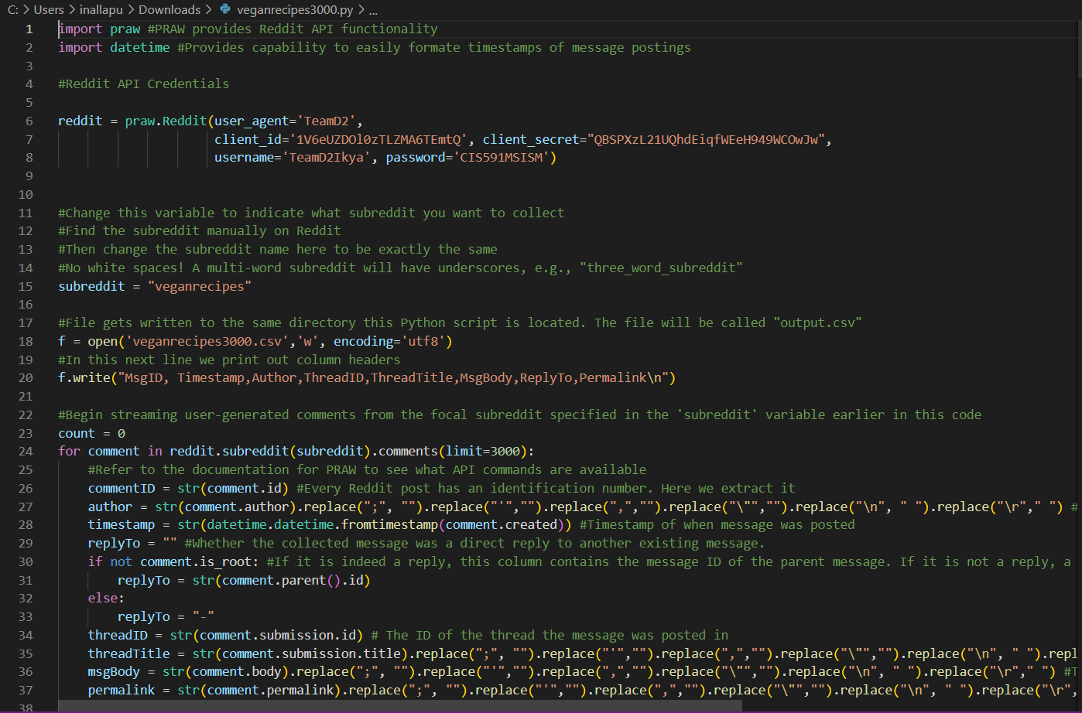
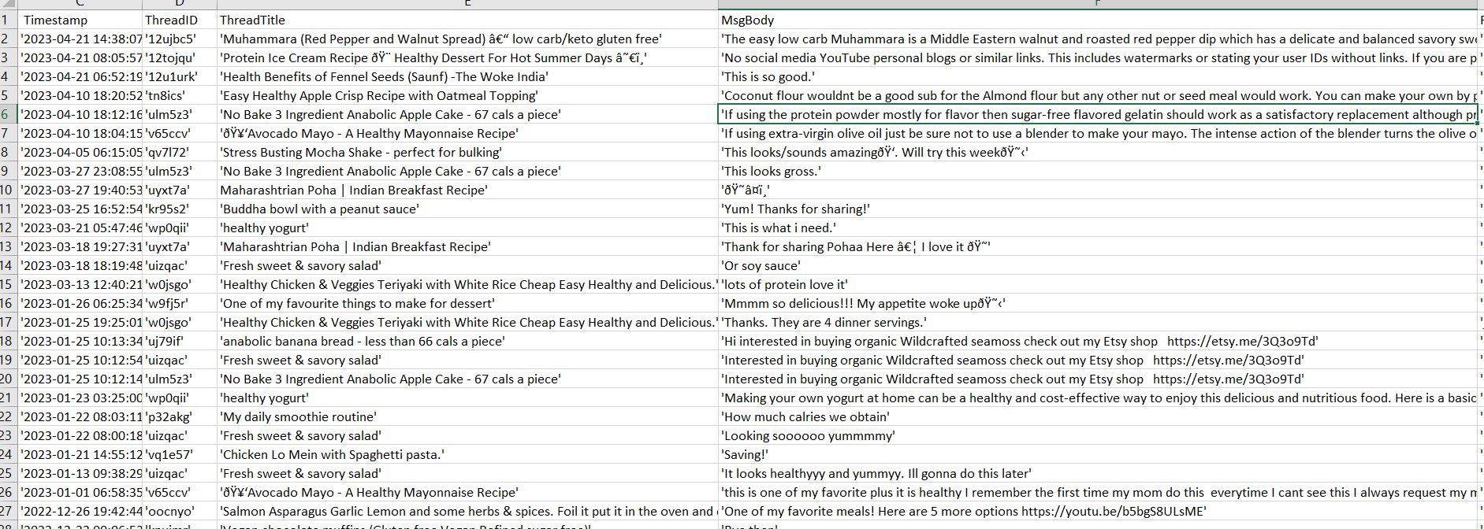
Praw & Pre-Processing

Slide 7
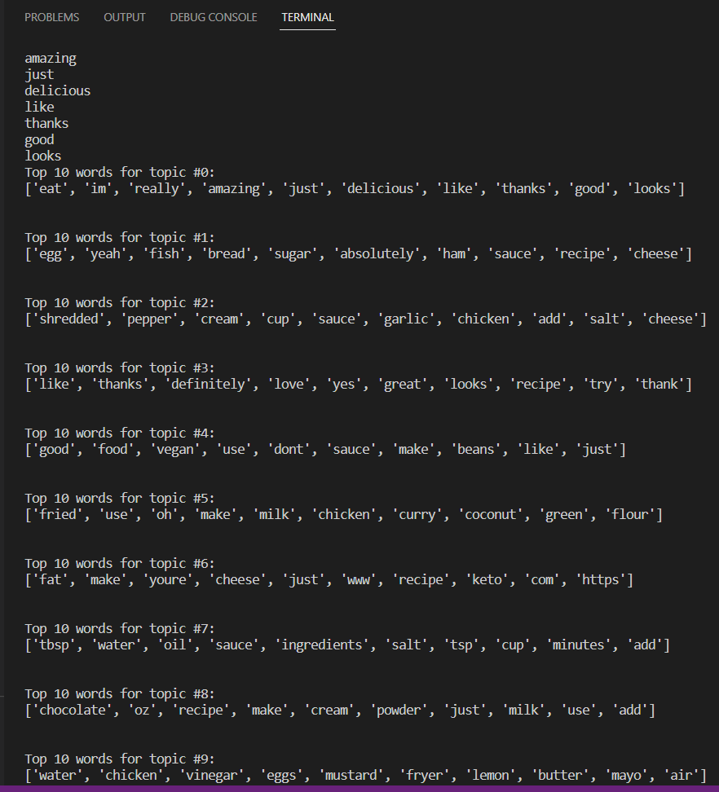
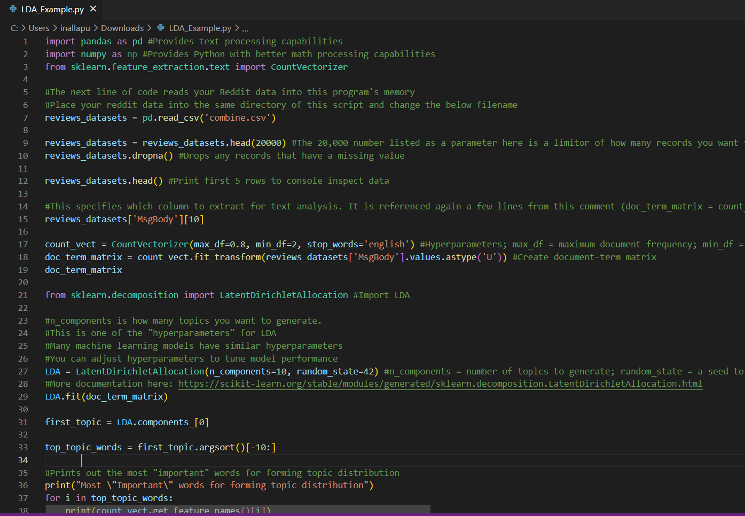
LDA Output

Slide 8
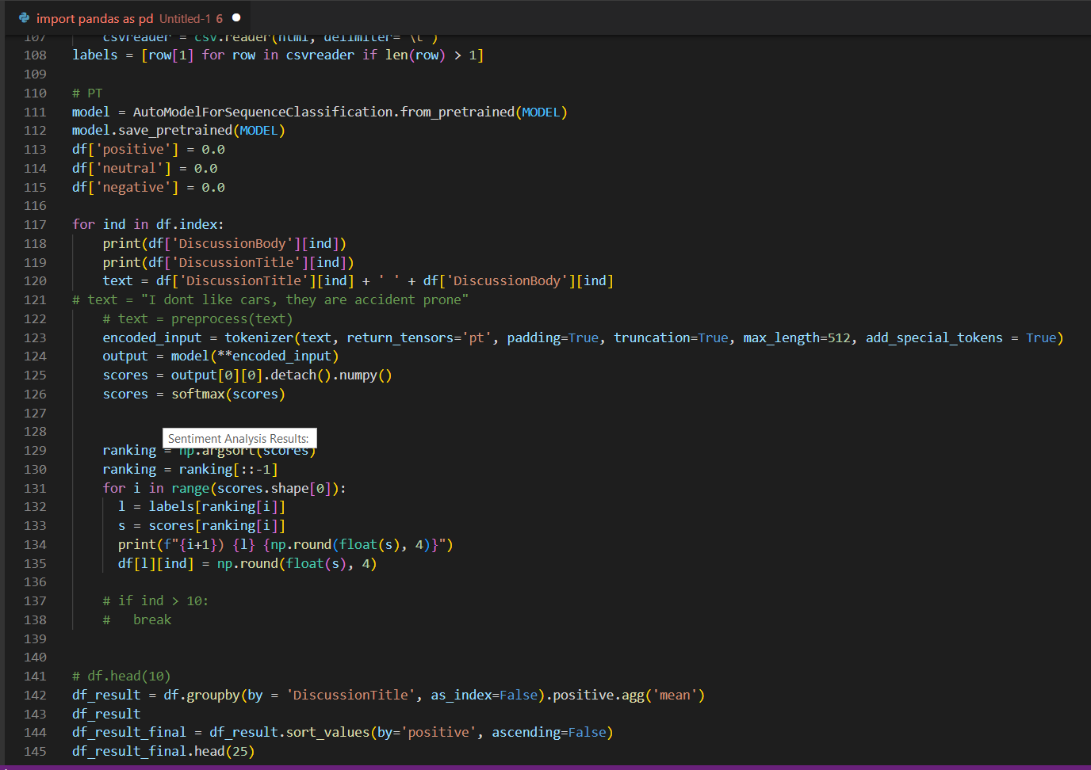
Sentiment Analysis
For this, we have used
AutoModelForSequenceClassification
TFAutoModelForSequenceClassification
AutoTokenizer
from transformers

Slide 9
How Sentiment Analysis Works?
Positive
Neutral
Negative

Slide 10
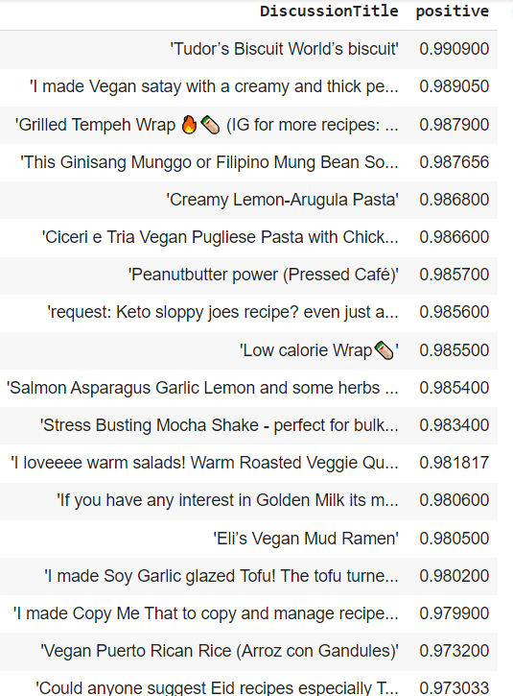
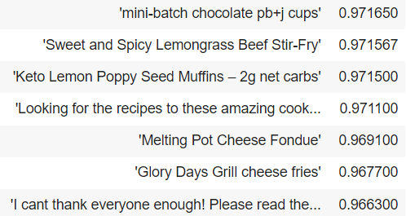
Final Output

Slide 11
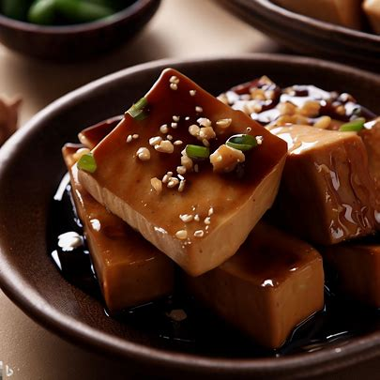
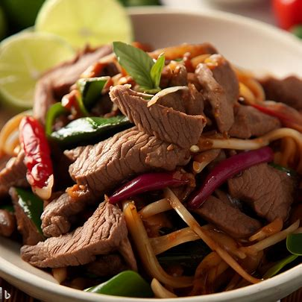
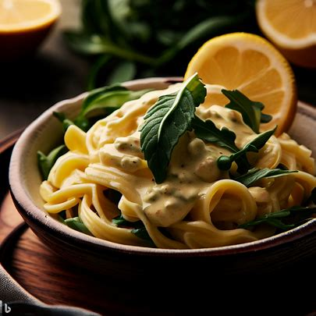
Recipe Recommendation Generated Images
Soy Garlic glazed Tofu
Sweet and Spicy
Lemongrass Beef Stir-Fry
Creamy Lemon-Arugula Pasta

Slide 12
Analysis interpretation
Some results had,
recipe names that we have used in our recommendation list,
generic comments like “looking for recipes.., mini-batch chocolate pb+j cups.., low calorie wrap”.
questions like “Could you suggest..?,
included ingredients asking how they can utilize them.
We can narrow down our approach by focusing on the most popular Instacart locations first and merge with our food choice statistics

Slide 13
Most Popular Instacart Locations In USA
Boston
Denver
Chicago
Los Angeles
Atlanta
Miami
Austin
Using Tableau

Slide 14
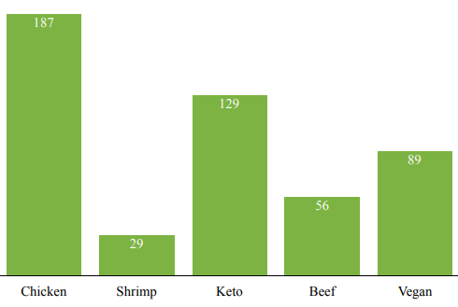
Preferred Recipe Ingredients/ Types
Using Lookerstudio

Slide 15
Future Work & Conclusion
With sentiment analysis, we have our trending recipes to enhance the application. But with more time, research, and a larger dataset we will be able to better understand the needs of our food lovers.
Since a one-size-fits-all recipe approach will not be enough, we will move on to understanding the order patterns of multiple customers and recommend them on the basis of customer preference and common interest.

Slide 16


Future Work & Conclusion
Recipe list
Long-term Approach
+
Recommendations
Content
Collab

Slide 17
TH NK YOU

